Slide 1
Can opinions of the current and potential employees predict performance and growth of a company?
H. Ada Lee
February 19th, 2019

Slide 2
Employee and employer relationship goes both ways

Slide 3
Can employee opinions can predict company’s performance

Slide 4
Using current/potential employers opinions to predict company’s future

Slide 5
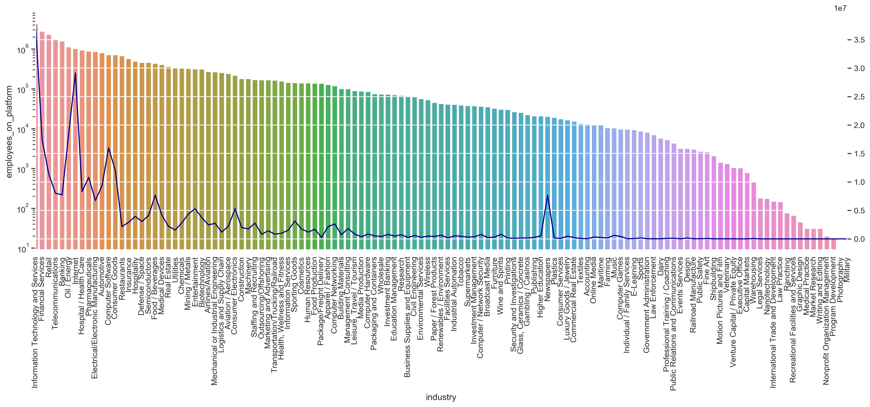
larger employee presence does not always mean large followers

Slide 6
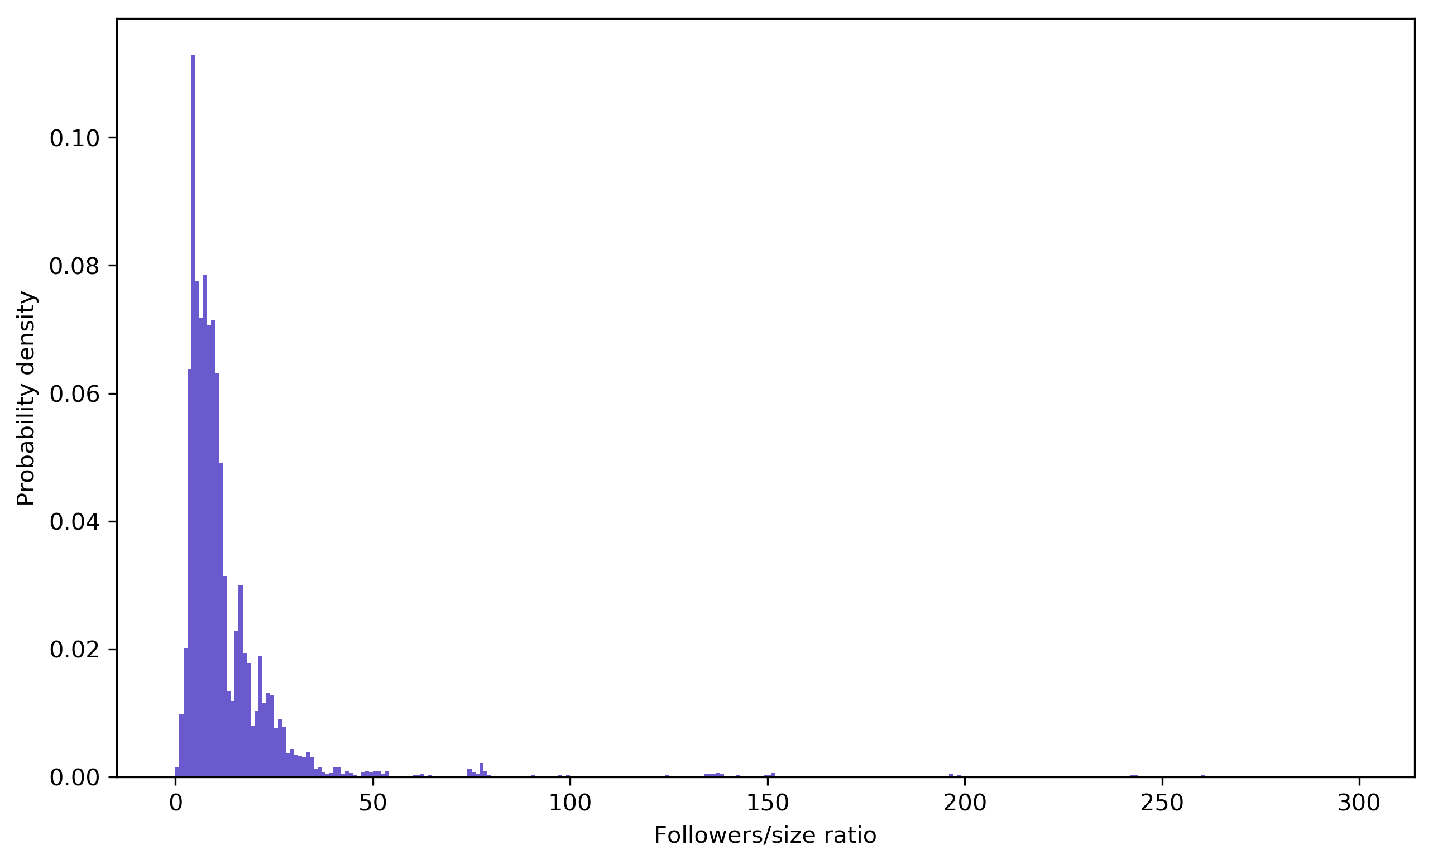
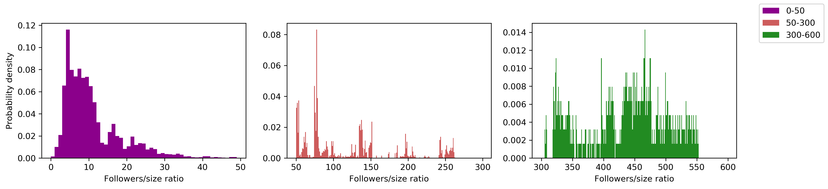
Followers/employee ratio can be divided into three groups

Slide 7
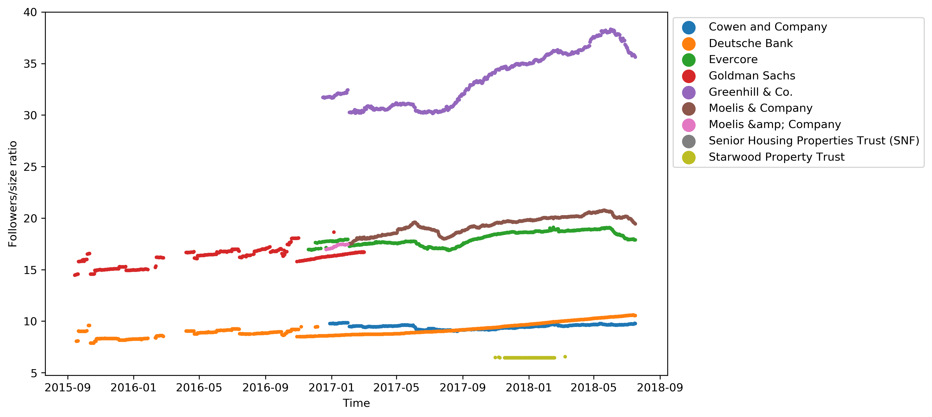
Some companies have higher online presence than some

